Slide 1
SRKW Diet Study
9/25 Updates
M. Ball

Slide 2
n= 458, but after filtering out NA pod and NA season:
Pod | n
J | 226
K | 54
L | 111
 | 391
Would love to fill in missing metadata if possible

Slide 3
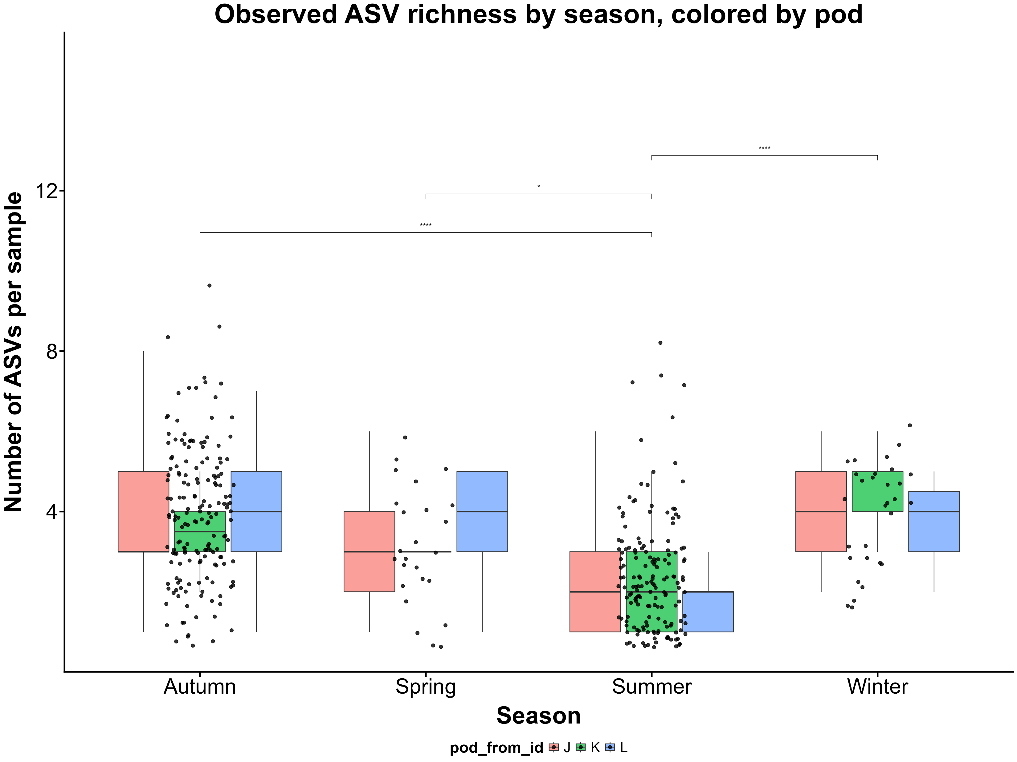

Slide 4
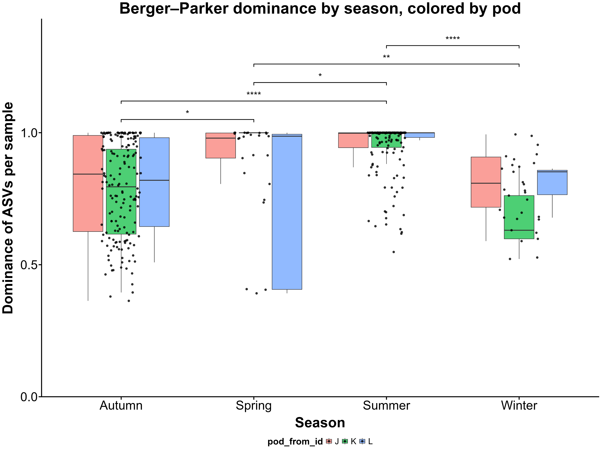

Slide 5
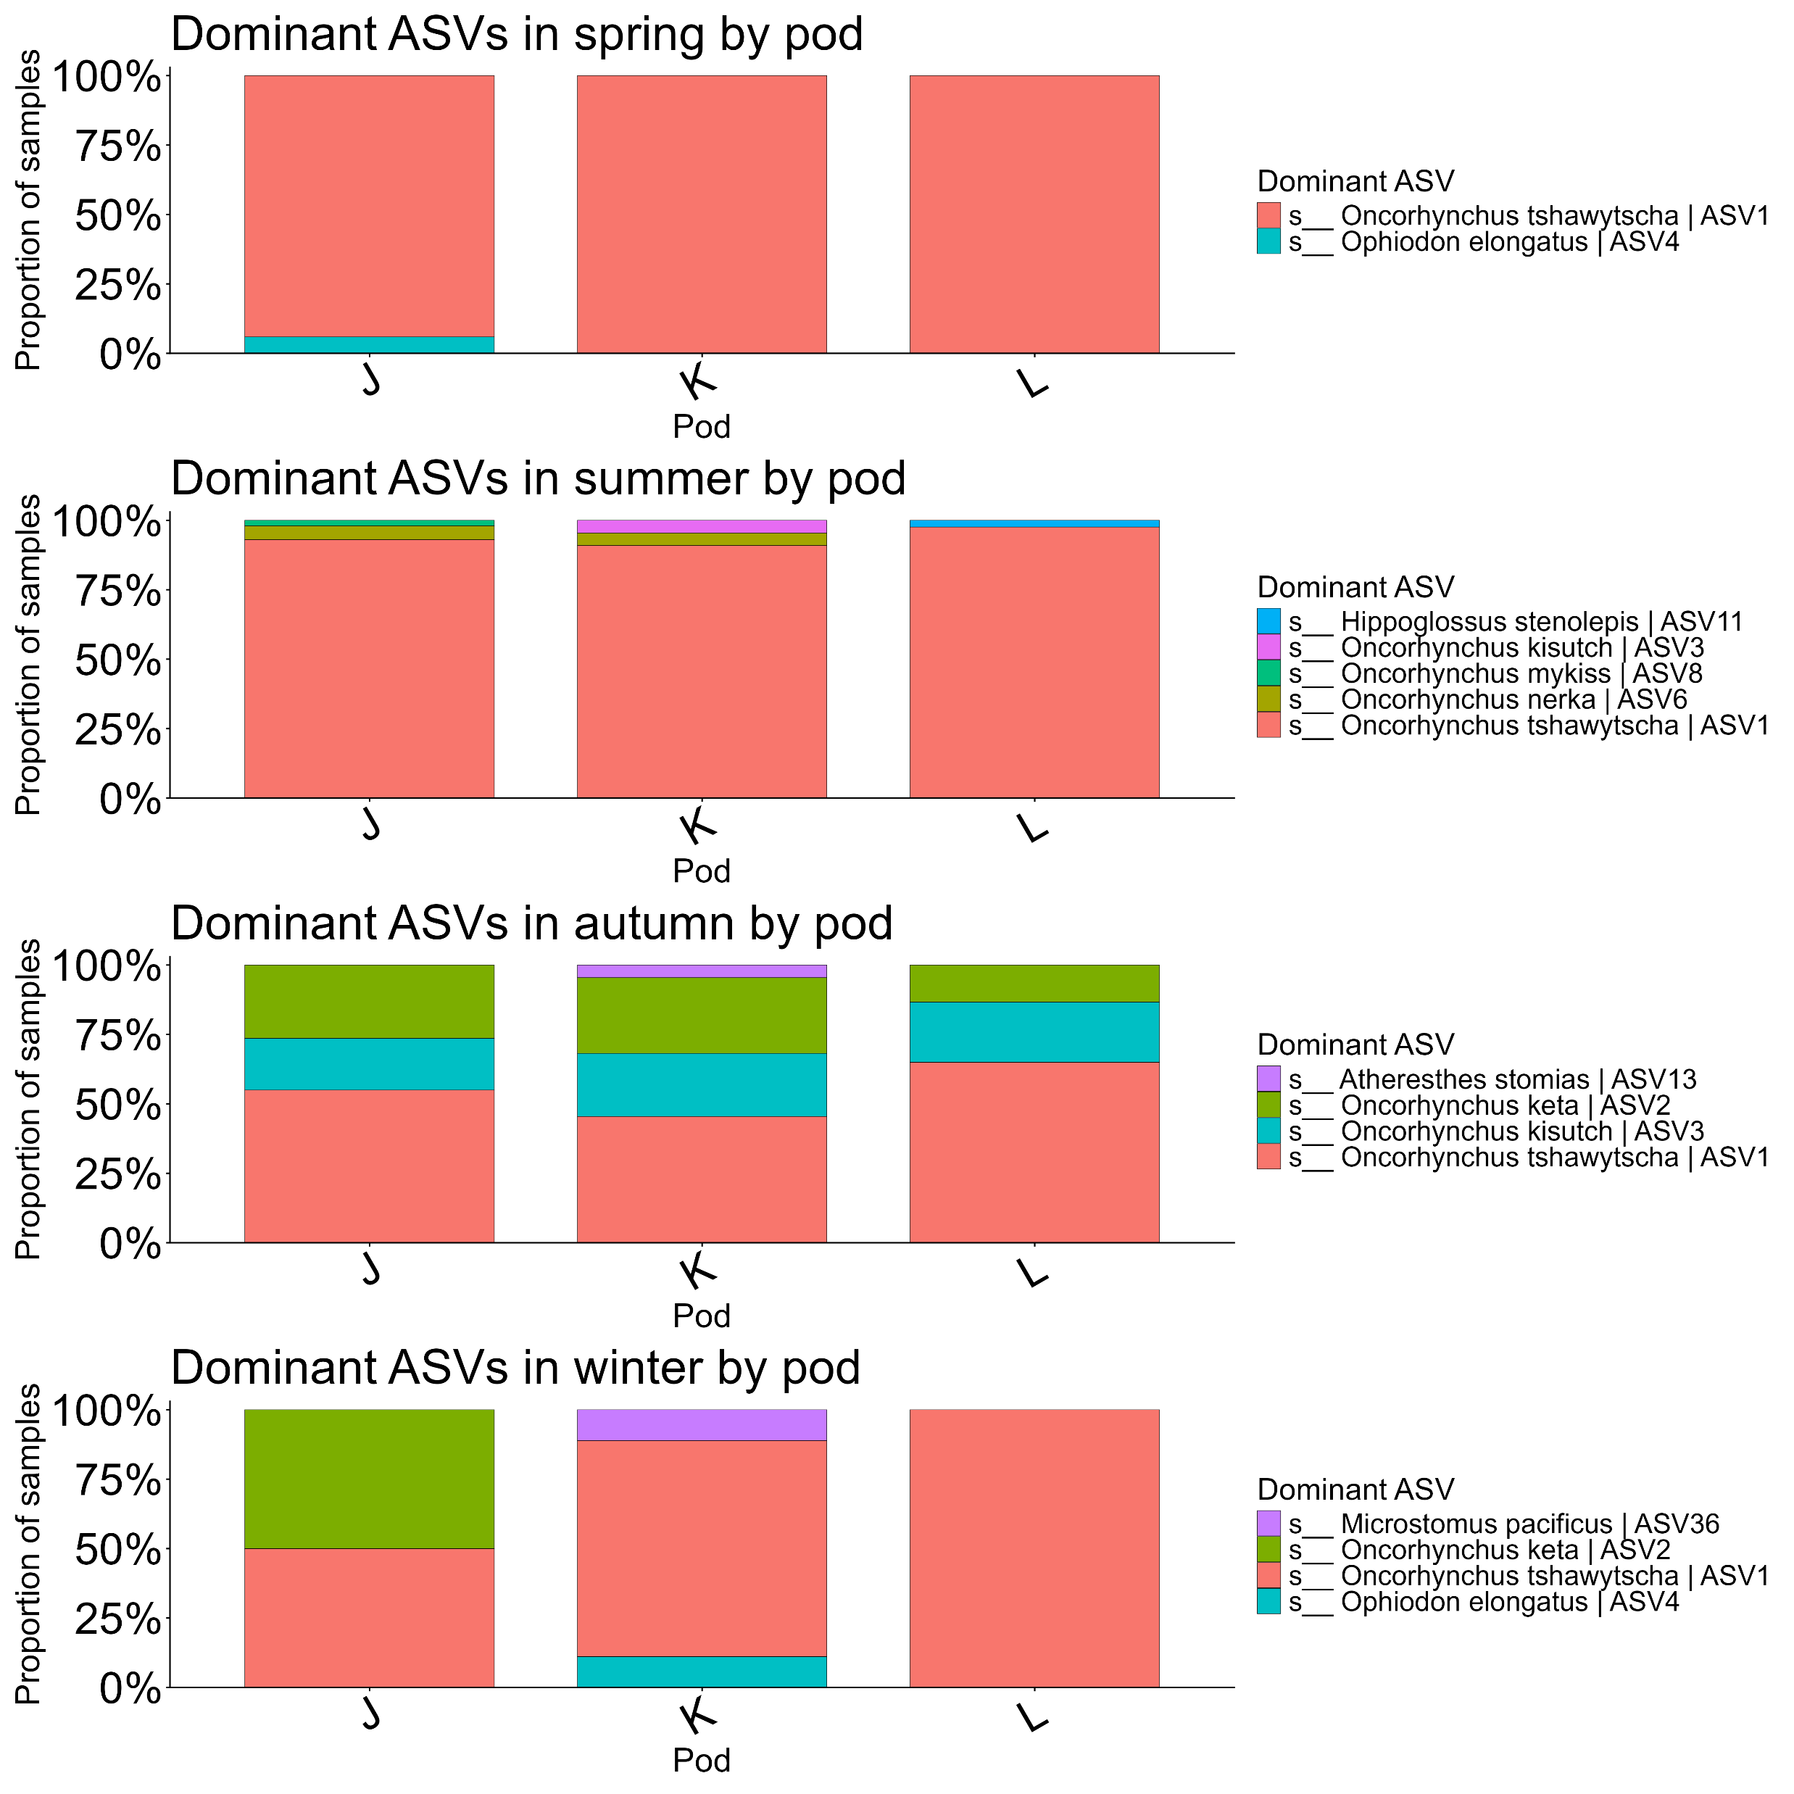

Slide 6
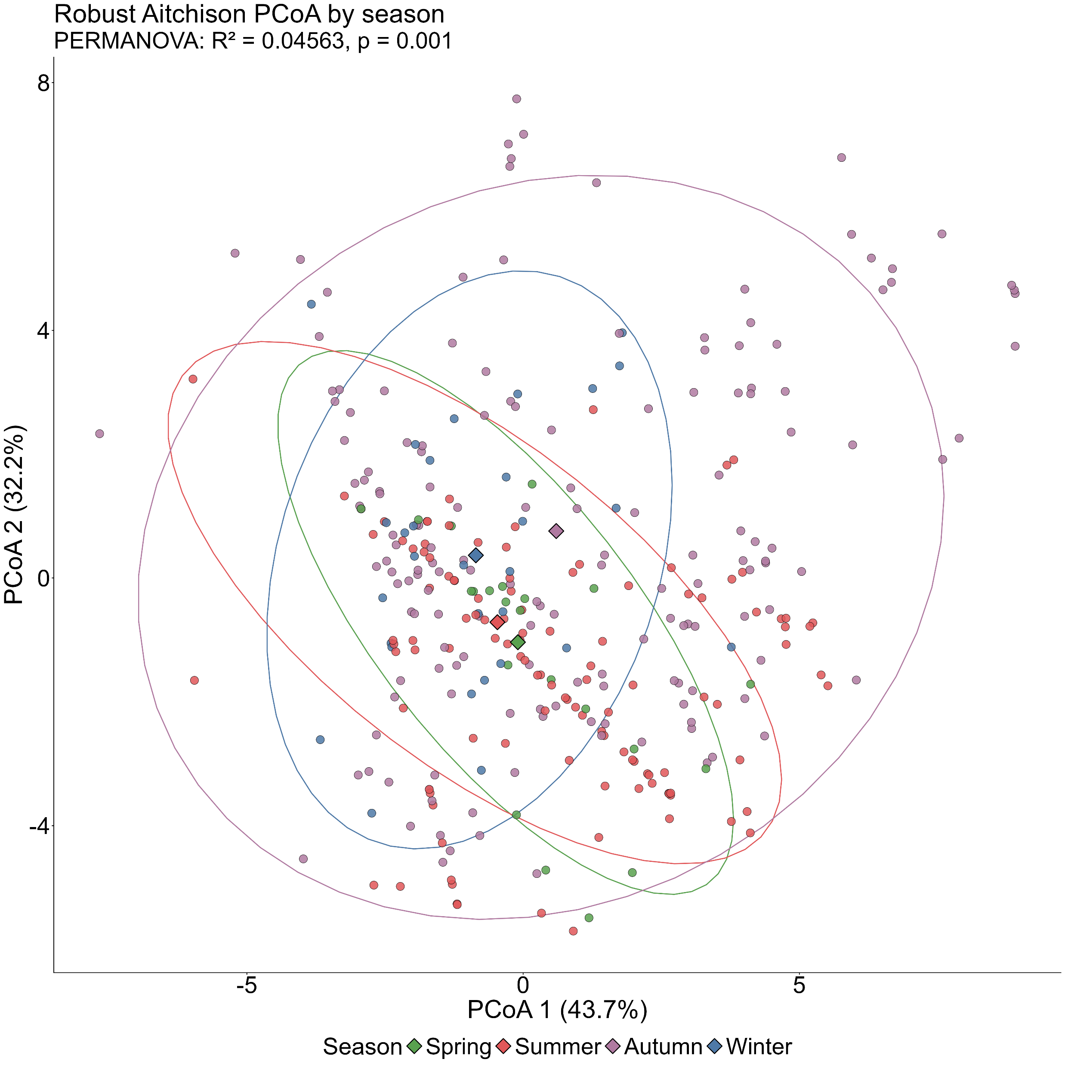
Significantly different:
autumn and summer
autumn and spring
spring and winter
autumn and winter

Slide 7
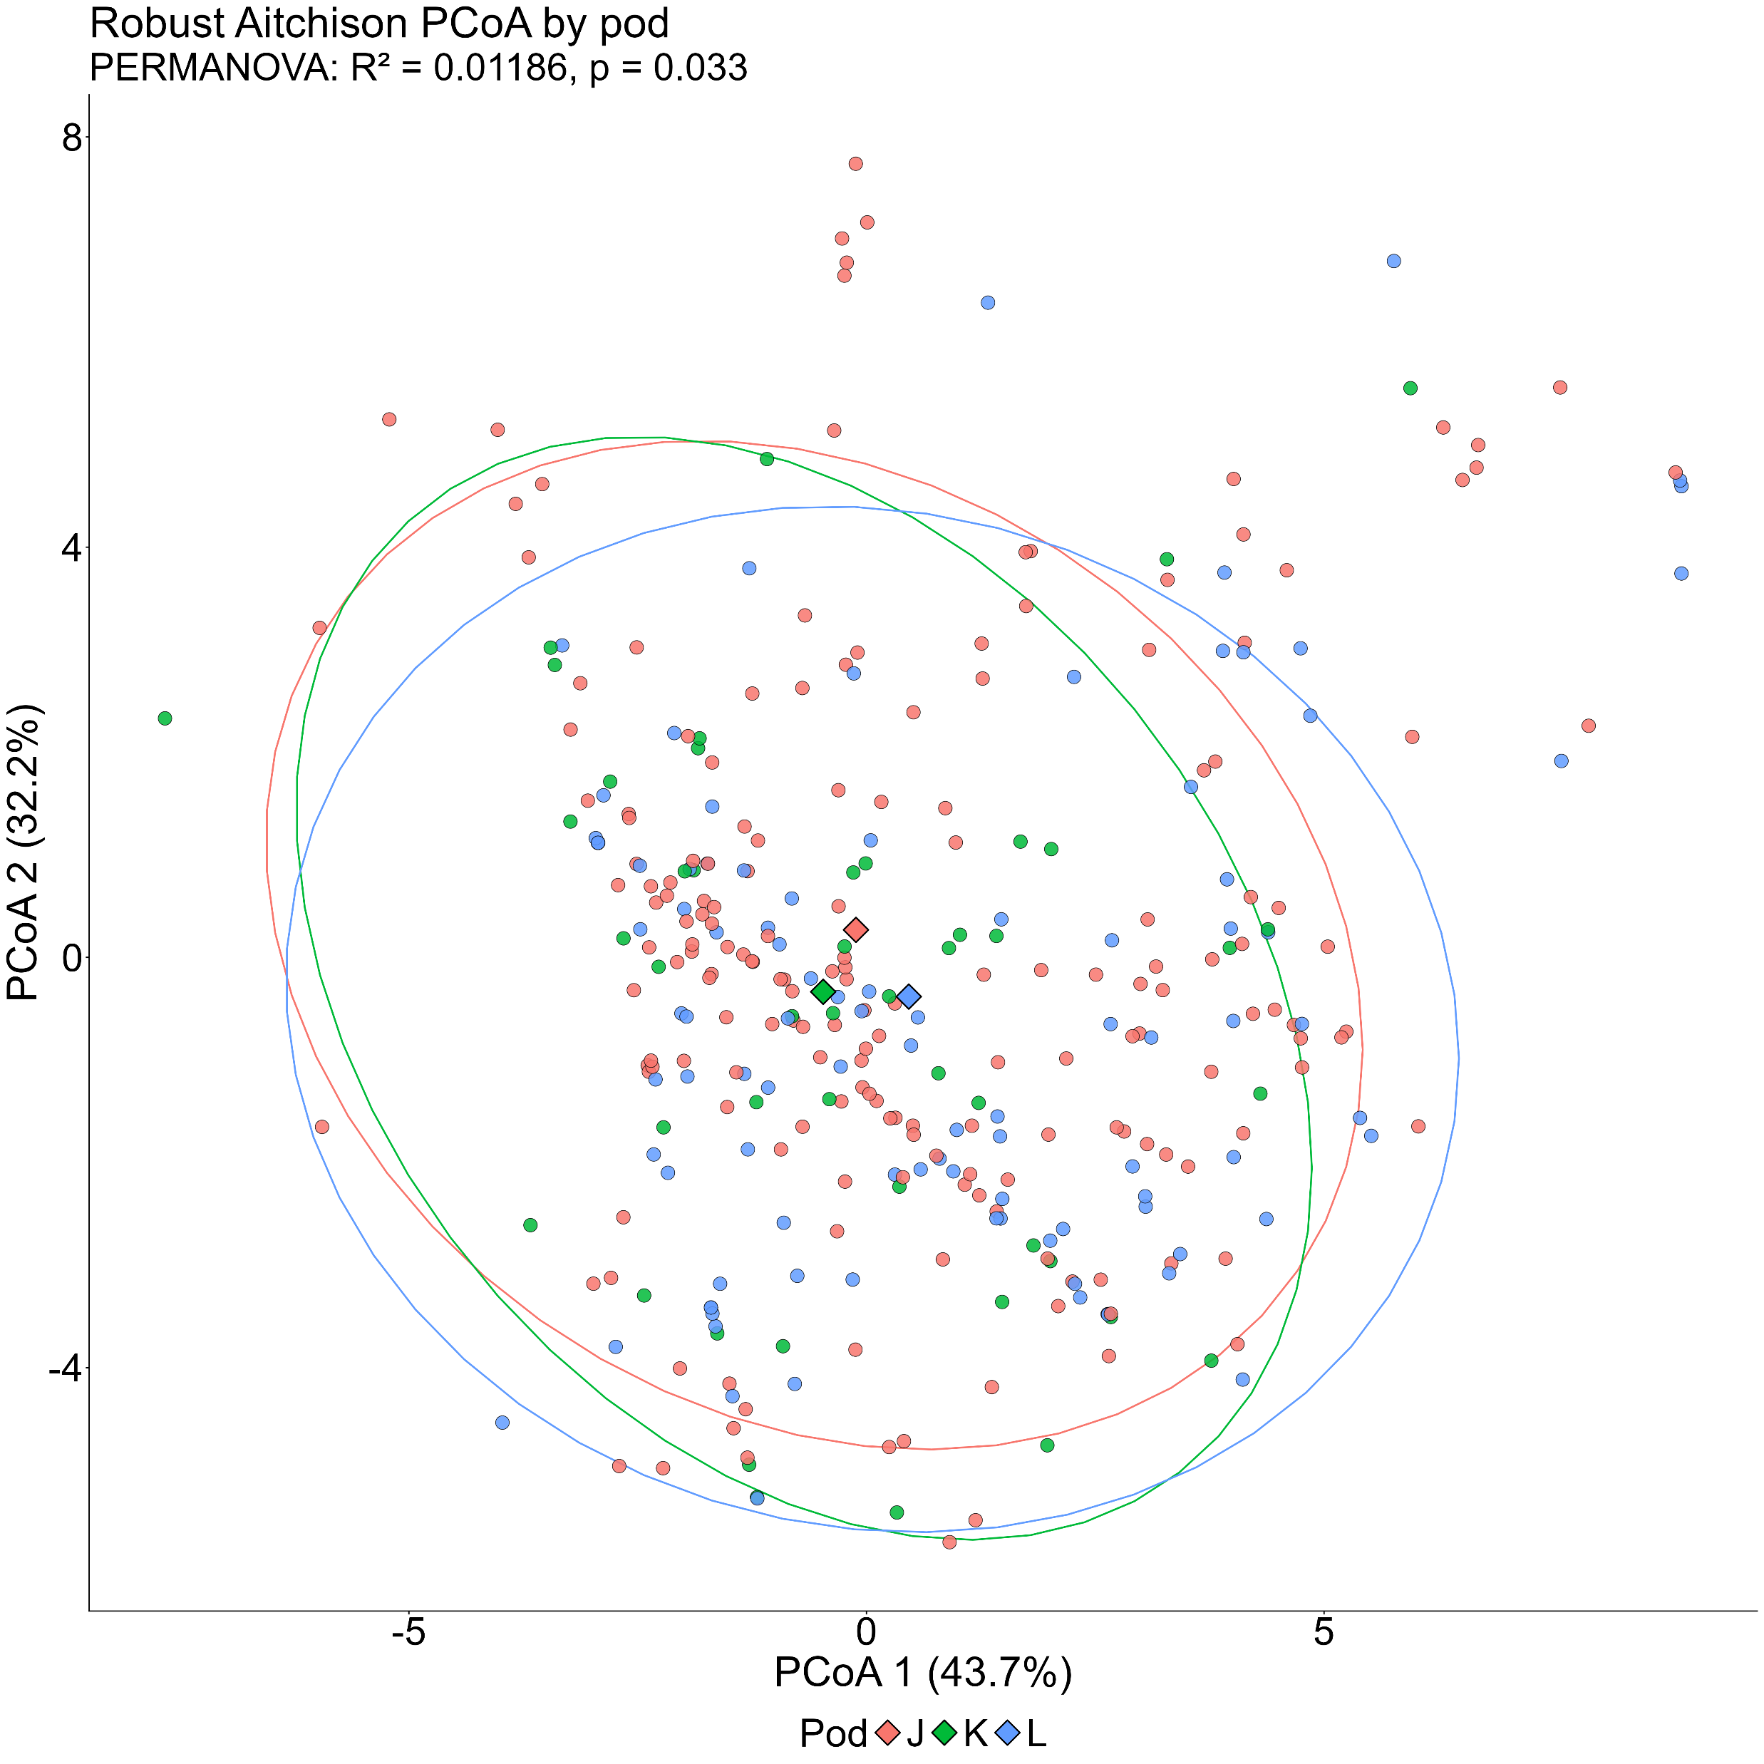
Significantly different:
J and L
K and L

Slide 8
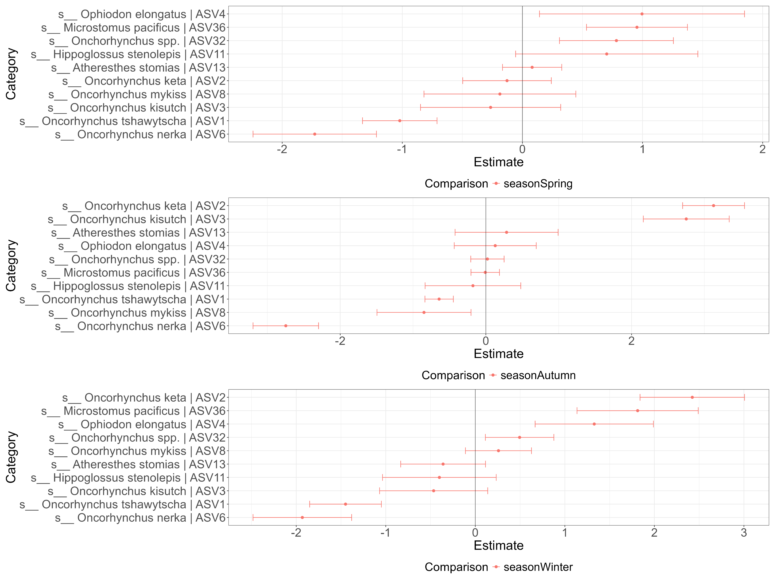

Slide 9
